Slide 1


CMR TECHNICAL CAMPUS
UGC AUTONOMOUS
Accredited by NBA & NAAC with ‘A’ Grade
Approved by AICTE,New Delhi and affiliated to JNTU,Hyderabad Kandlakoya (V), Medchal Road, Hyderabad -501401, Telangana
DEPARTMENT OF COMPUTER SCIENCE AND ENGINEERING
AN EFFICIENT SPAM DETECTION TECHNIQUE FOR IOT DEVICES USING MACHINE LEARNING
BATCH NO-01
UNDER THE GUIDANCE OF :
DR.K.SRUJAN RAJU
(Professor of CSE)
PRESENTED BY:
P.SRAVANI : 207R1A05N1
G.VENKATESHWARLU: 207R1A05L3

Slide 2
CONTENTS
ABSTRACT
EXISTING SYSTEM
DISADVANTAGES OF EXISTING SYSTEM
PROPOSED SYSTEM
ADVANTAGES OF PROPOSED SYSTEM
HARDWARE AND SOFTWARE REQUIREMENTS
ARCHITECTURE
MODULES
UML DIAGRAMS
SAMPLE CODE
RESULTS
NOVELTY OF THE PROJECT
CONCLUSION
FUTURE SCOPE
REFERENCES
GITHUB LINK

Slide 3
ABSTRACT
Introduction to the Internet of Things (IoT) and its rapid growth, with an expected 25 billion connected devices by 2020.
Highlighting the challenge of managing the increasing volume of data from IoT devices, which varies in quality and comes from diverse sources.
Emphasis on the role of machine learning in enhancing security and usability in IoT systems, while acknowledging the potential for attackers to exploit vulnerabilities.
Proposal of a solution focused on using machine learning to detect spam in IoT devices, aiming to increase security measures.
A framework for spam detection in IoT using machine learning, with the validation of results using a specific dataset.
Accuracy and effectiveness of the proposed scheme compared to existing methods.

Slide 4
EXISTING SYSTEM
In the existing system ,it contains weak firewalls so that the spam attacks are not properly detected.
DDoS attacks ,Internet attacks ,RFID attacks ,NFC attacks can be detected by existing system but it contains poor performance and less accurate.
This take a lot of time to detect the attacks so existing system cannot find the attacker easily.
The existing system doesn’t have any type of detectors and supporters to detect the spam.
Suggests conditional privacy protection using random public keys to prevent attackers from creating the same profile. So probability of attacks is high.

Slide 5
DISADVANTAGES OF EXISTING SYSTEM
This system is a more time taking process to detect a spam.
It can be easily attacked through unauthorised users.
It cannot detect the attackers.
It has absence of machine learning algorithms.
It is less Accurate.
It is less Efficient.
Performance is low.

Slide 6
PROPOSED SYSTEM
The proposed scheme involves the validation of spam detection using five different machine learning models such as LOGISTIC REGRESSION,SVM etc, indicating a comprehensive approach to evaluating the effectiveness of the solution.
An algorithm is proposed to compute the spamicity score for each model, which is then utilized for detection and intelligent decision-making.
This suggests a structured approach to analyzing and classifying spam in IoT devices.
Based on the spamicity score computed in the previous step, the proposed system conducts an analysis of IoT device reliability using different evaluation metrics.
This indicates a holistic approach to assessing the trustworthiness and reliability of IoT devices.

Slide 7
ADVANTAGES OF PROPOSED SYSTEM
By employing machine learning algorithms for spam detection, the proposed system enhances the security of IoT devices.
Utilizing multiple machine learning models allows for a more accurate detection of spam, reducing false positives and false negatives compared to traditional rule-based methods.
The proposed system can scale to accommodate the growing volume of IoT devices and data.
The framework for spam detection using machine learning is customizable, allowing for the adaptation of different models and algorithms based on specific use cases and requirements.
With the ability to process data in real-time, the proposed system can quickly detect and respond to spam attacks, minimizing their impact on IoT device functionality and performance.
Machine learning-based approaches are adaptable to new and evolving spam attack techniques.
The proposed system enables data-driven decision-making regarding the reliability and trustworthiness of IoT devices, enhancing overall system security.

Slide 8
HARDWARE AND SOFTWARE REQUIREMENTS
HARDWARE REQUIREMENTS
SOFTWARE REQUIREMENTS
Processor - Intel i3 or Above.
RAM - 4 GB or Above.
Hard Disk - 20 GB.
Key Board - Standard Windows Keyboard.
Mouse - Two or Three Button Mouse.
Monitor - SVGA.
Operating system : Windows 7 or Above.
Coding Language : Python.
Front-End : Html,Css,Javascript.
Back-End : MySql, MongoDB.
FrameWork : Dyjango.

Slide 9
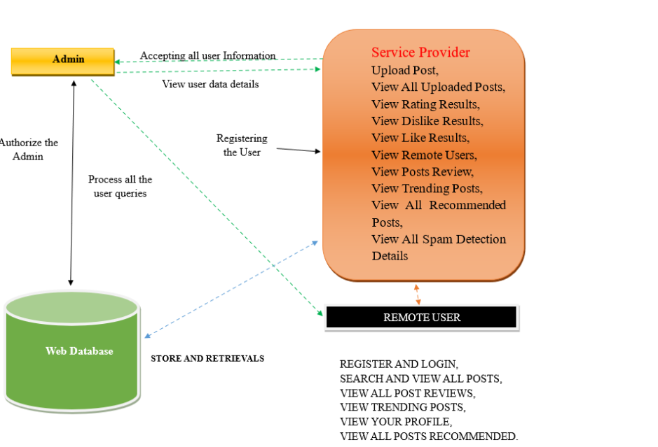
ARCHITECTURE

Slide 10
MODULES
SERVICE PROVIDER:
PURPOSE : Login , Train & Test Data ,View Accuracy , Predict Spam , Manage Users.
VIEW AND AUTHORIZE USERS:
PURPOSE : Admin : View & Authorize Users.
REMOTE USER:
PURPOSE : Register , Login , Predict Spam , View Profile.

Slide 11
UML DIAGRAMS
__________________________________________________________

Slide 12
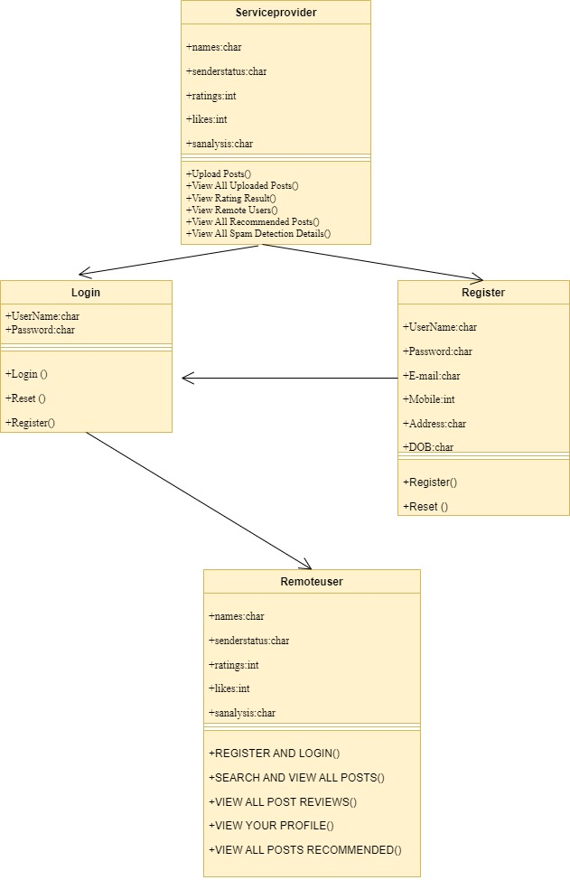
CLASS DIAGRAM

Slide 13
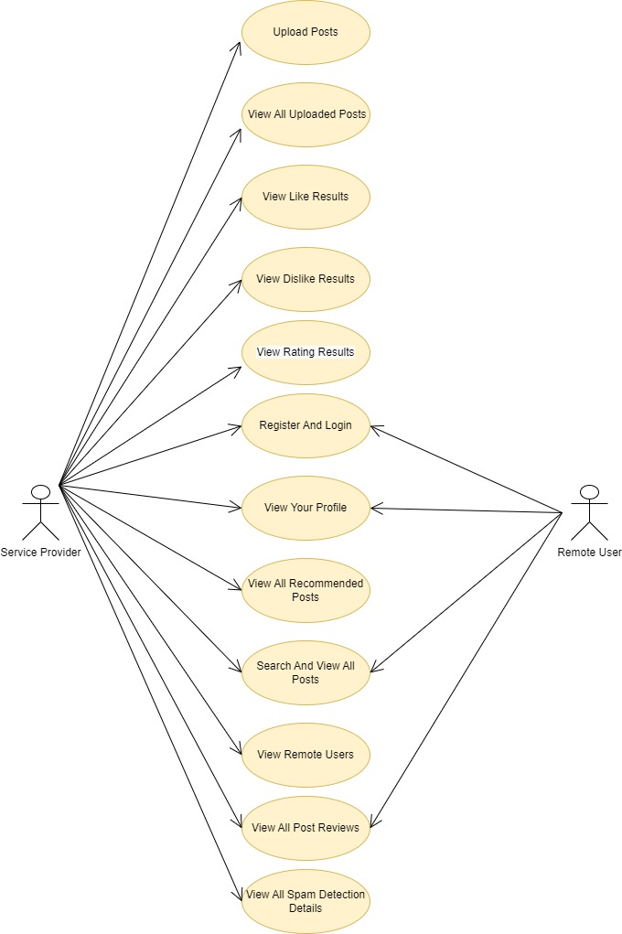
USECASE DIAGRAM

Slide 14
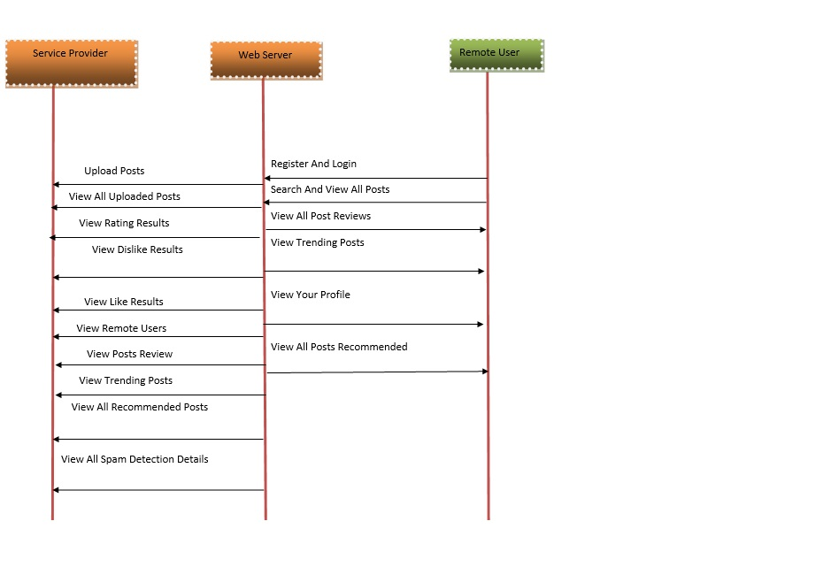
SEQUENCE DIAGRAM

Slide 15
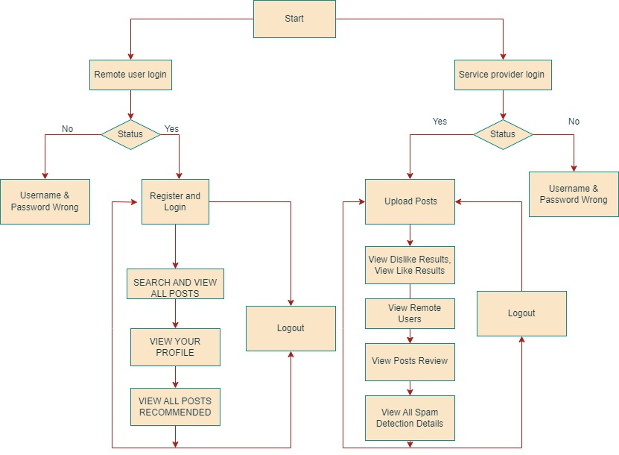
ACTIVITY DIAGRAM

Slide 16
SAMPLE CODE
from django import forms
from Remote_User.models import ClientRegister_Model
class ClientRegister_Form(forms.ModelForm):
password = forms.CharField(widget=forms.PasswordInput())
email = forms.EmailField(required=True)
class Meta:
model = ClientRegister_Model
fields = ("username","email","password","phoneno","country","state","city")
from django.db import models
from django.db.models import CASCADE
class ClientRegister_Model(models.Model):
username = models.CharField(max_length=30)
email = models.EmailField(max_length=30)
password = models.CharField(max_length=10)
phoneno = models.CharField(max_length=10)
country = models.CharField(max_length=30)
state = models.CharField(max_length=30)
city = models.CharField(max_length=30)
class Spam_Prediction(models.Model):
Message_Id= models.CharField(max_length=300)
IOT_Message= models.CharField(max_length=300000)
Message_Date= models.CharField(max_length=300)
Prediction= models.CharField(max_length=300)
class detection_accuracy(models.Model):
names = models.CharField(max_length=300)
ratio = models.CharField(max_length=300)
class detection_ratio(models.Model):
names = models.CharField(max_length=300)
ratio = models.CharField(max_length=300)
from django.db.models import Count
from django.db.models import Q
from django.shortcuts import render, redirect, get_object_or_404
import datetime
import openpyxl
import numpy as np # linear algebra
import pandas as pd # data processing, CSV file I/O (e.g. pd.read_csv)
import matplotlib.pyplot as plt

Slide 17
SAMPLE CODE
# SVM Model
print("SVM")
from sklearn import svm
lin_clf = svm.LinearSVC()
lin_clf.fit(X_train, y_train)
predict_svm = lin_clf.predict(X_test)
svm_acc = accuracy_score(y_test, predict_svm) * 100
print(svm_acc)
print("CLASSIFICATION REPORT")
print(classification_report(y_test, predict_svm))
print("CONFUSION MATRIX")
print(confusion_matrix(y_test, predict_svm))
models.append(('svm', lin_clf))
print("Logistic Regression")
from sklearn.linear_model import LogisticRegression
reg = LogisticRegression(random_state=0, solver='lbfgs').fit(X_train, y_train)
y_pred = reg.predict(X_test)
print("ACCURACY")
print(accuracy_score(y_test, y_pred) * 100)
print("CLASSIFICATION REPORT")
print(classification_report(y_test, y_pred))
print("CONFUSION MATRIX")
print(confusion_matrix(y_test, y_pred))
models.append(('logistic', reg))
print("Decision Tree Classifier")
dtc = DecisionTreeClassifier()
dtc.fit(X_train, y_train)
dtcpredict = dtc.predict(X_test)
print("ACCURACY")
print(accuracy_score(y_test, dtcpredict) * 100)
print("CLASSIFICATION REPORT")
print(classification_report(y_test, dtcpredict))
print("CONFUSION MATRIX")
print(confusion_matrix(y_test, dtcpredict))
classifier = VotingClassifier(models)
classifier.fit(X_train, y_train)
y_pred = classifier.predict(X_test)

Slide 18
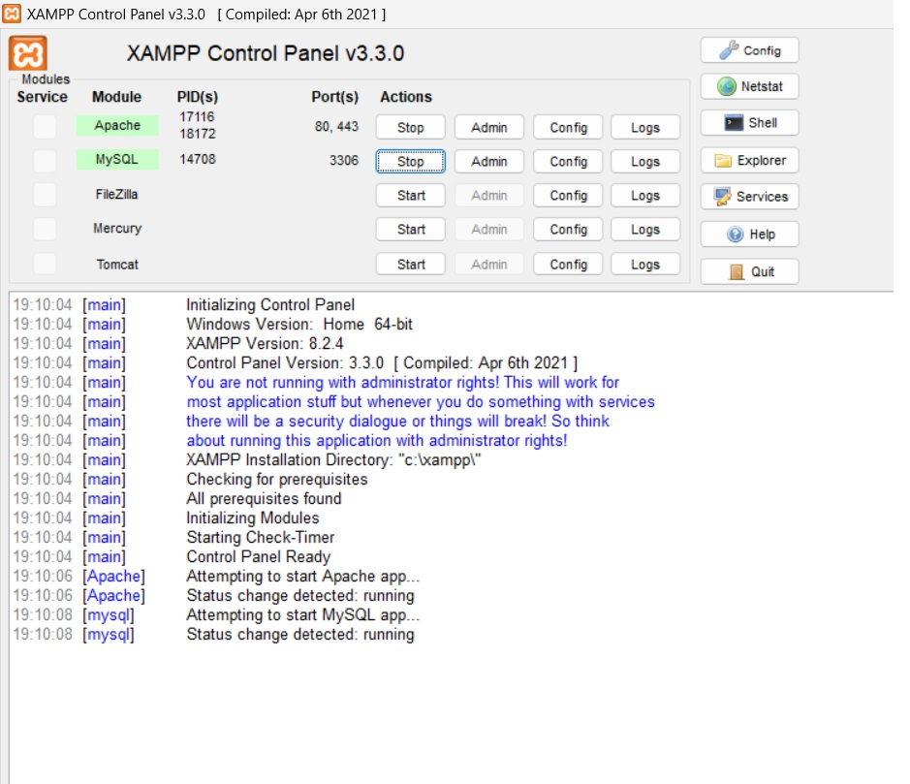
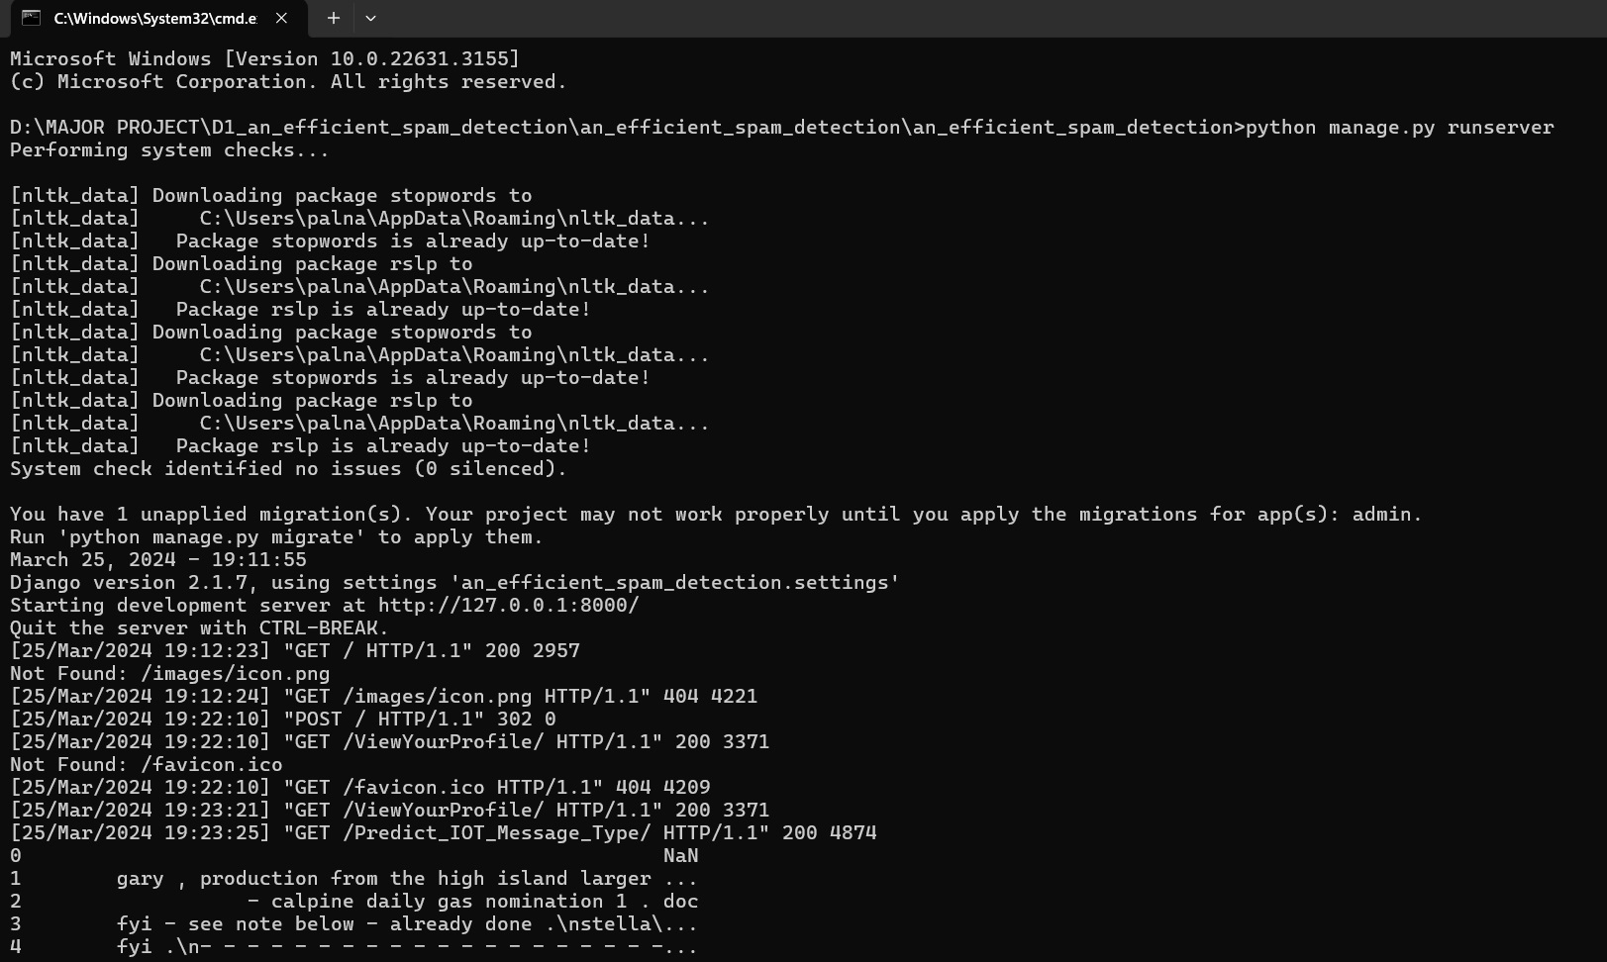
RESULTS
RUN XAMPP AND TURN ON APACHE AND MYSQL ACTIONS
RUN COMMAND PROMPT AND EXECUTE CODE

Slide 19

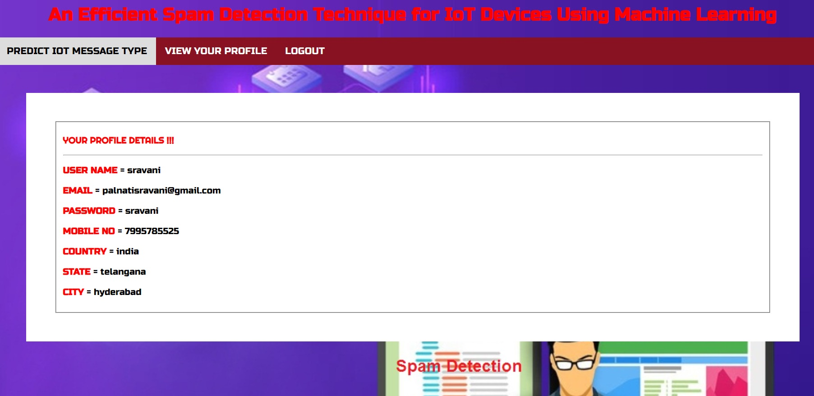
RESULTS
USER LOGIN
VIEW USER PROFILE

Slide 20
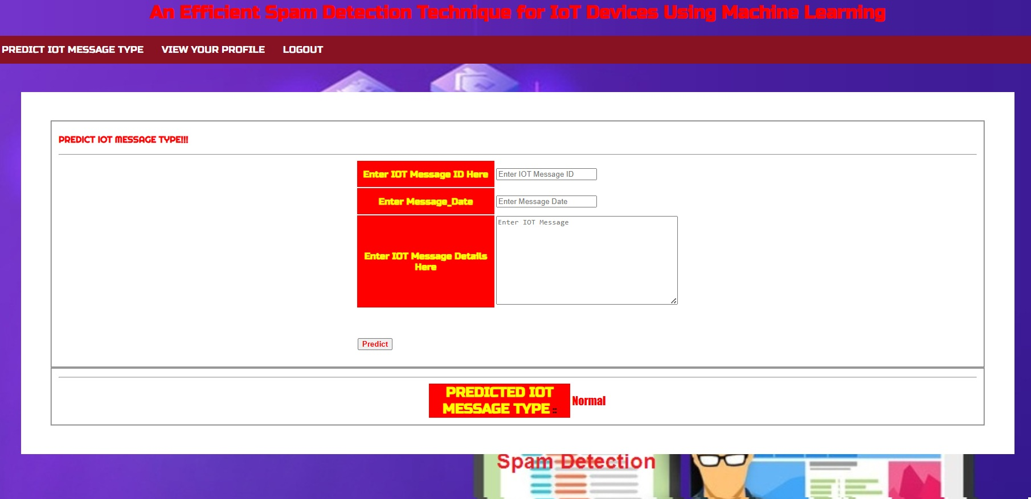
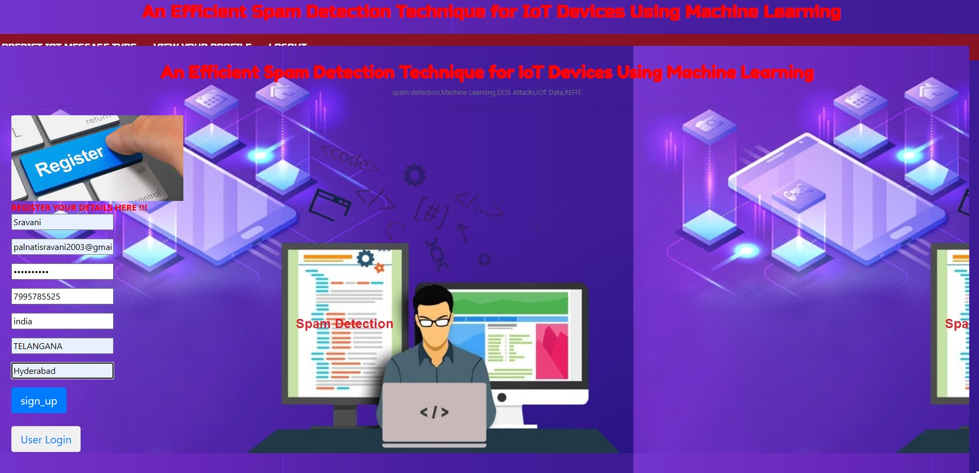
RESULTS
PREDICT IOT MESSAGE TYPE
REGISTER FOR REMOTE USER LOGIN

Slide 21
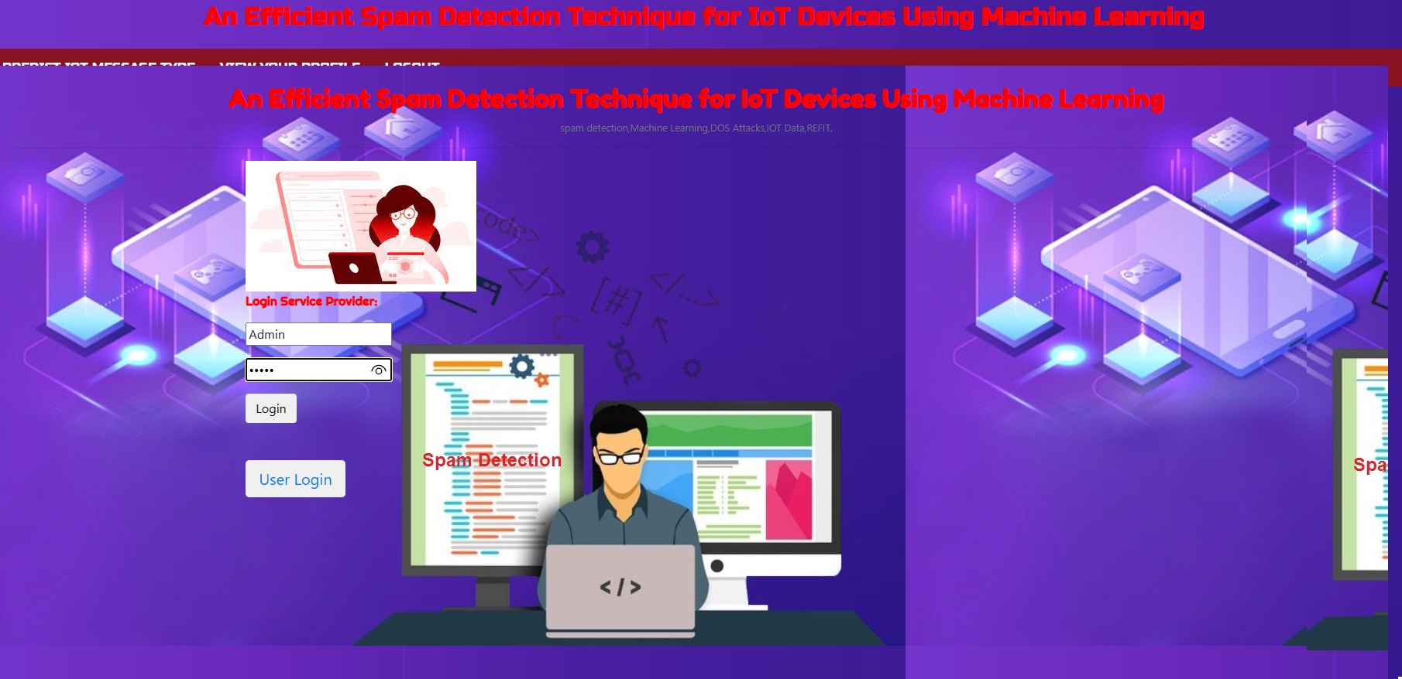
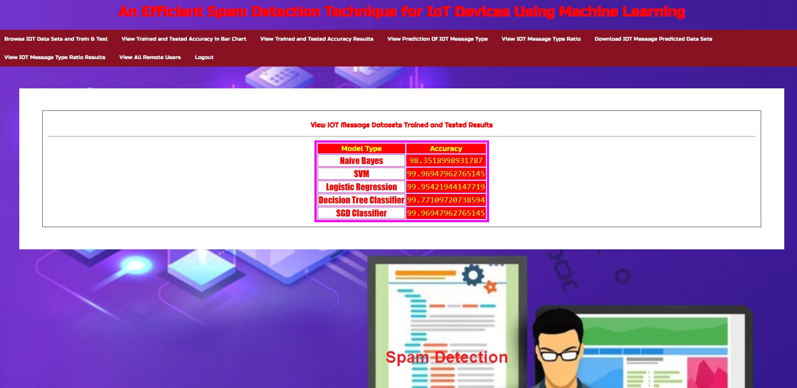
RESULTS
SERVICE PROVIDER LOGIN
VIEW IOT MESSAGE DATASETS TRAINED AND TESTED

Slide 22
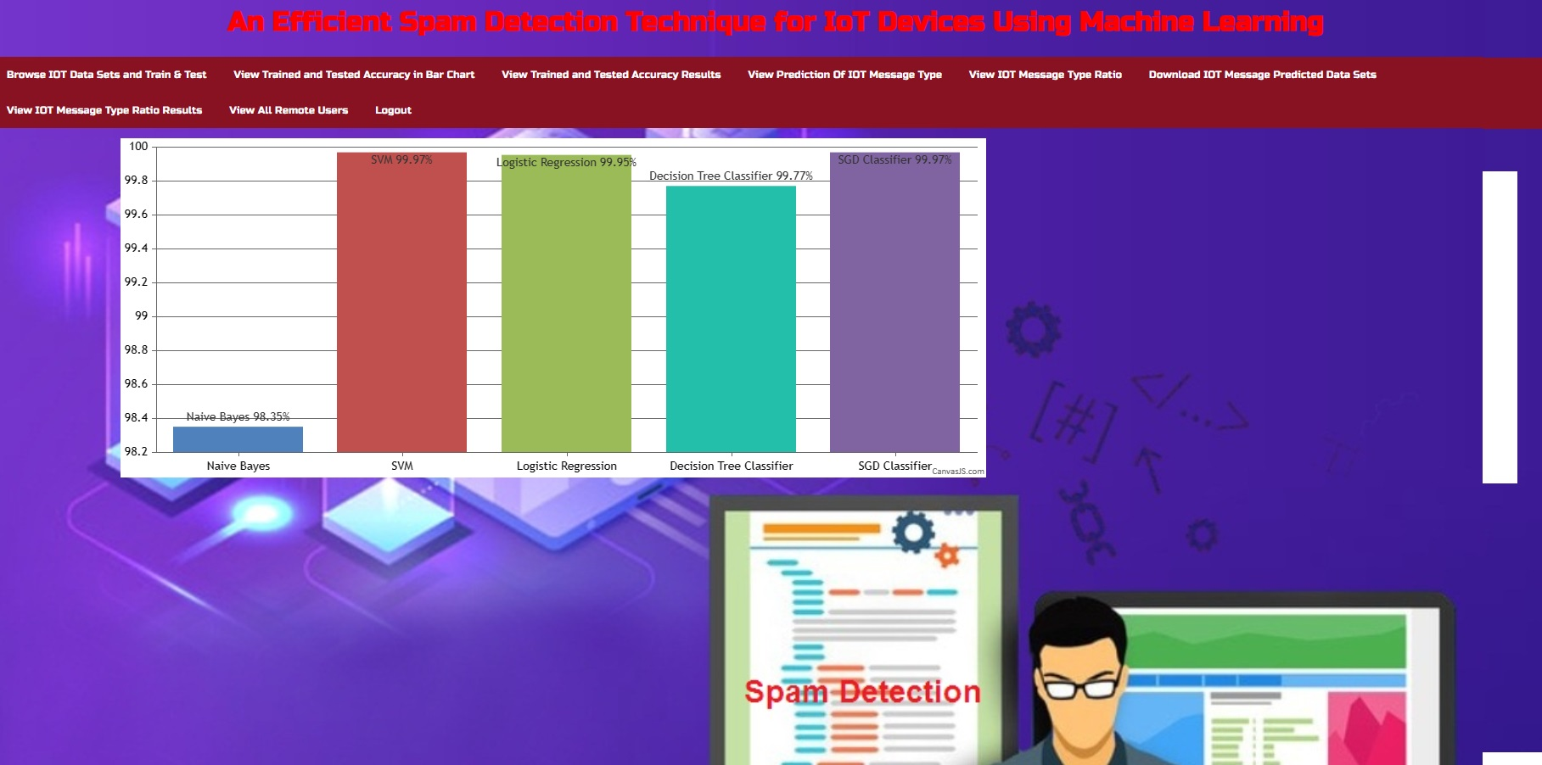
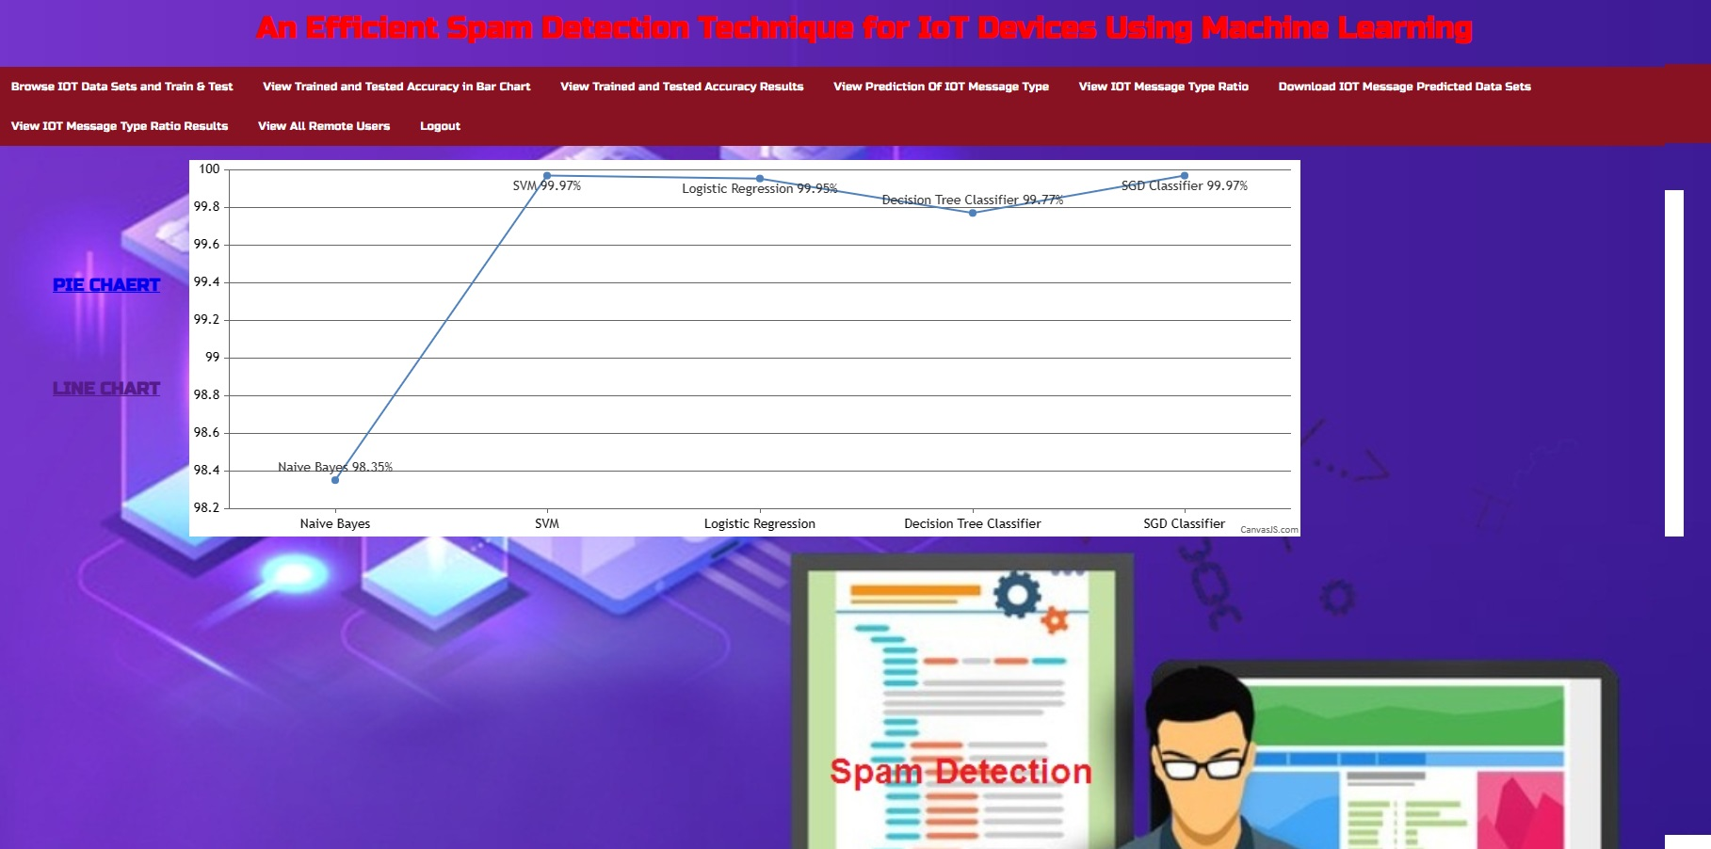
RESULTS
VIEW TRAINED AND TESTED ACCURACY BARGRAPH
VIEW TRAINED AND TESTED ACCURACY RESULTS

Slide 23
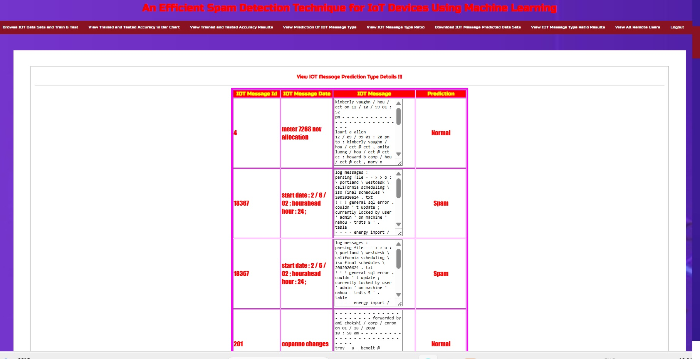
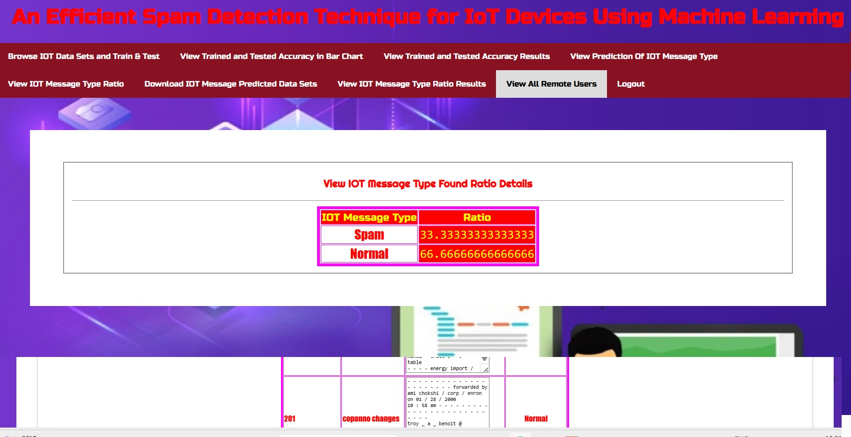
RESULTS
VIEW PREDICTION OF IOT MESSAGE TYPE
VIEW IOT MESSAGE TYPE RATIO

Slide 24
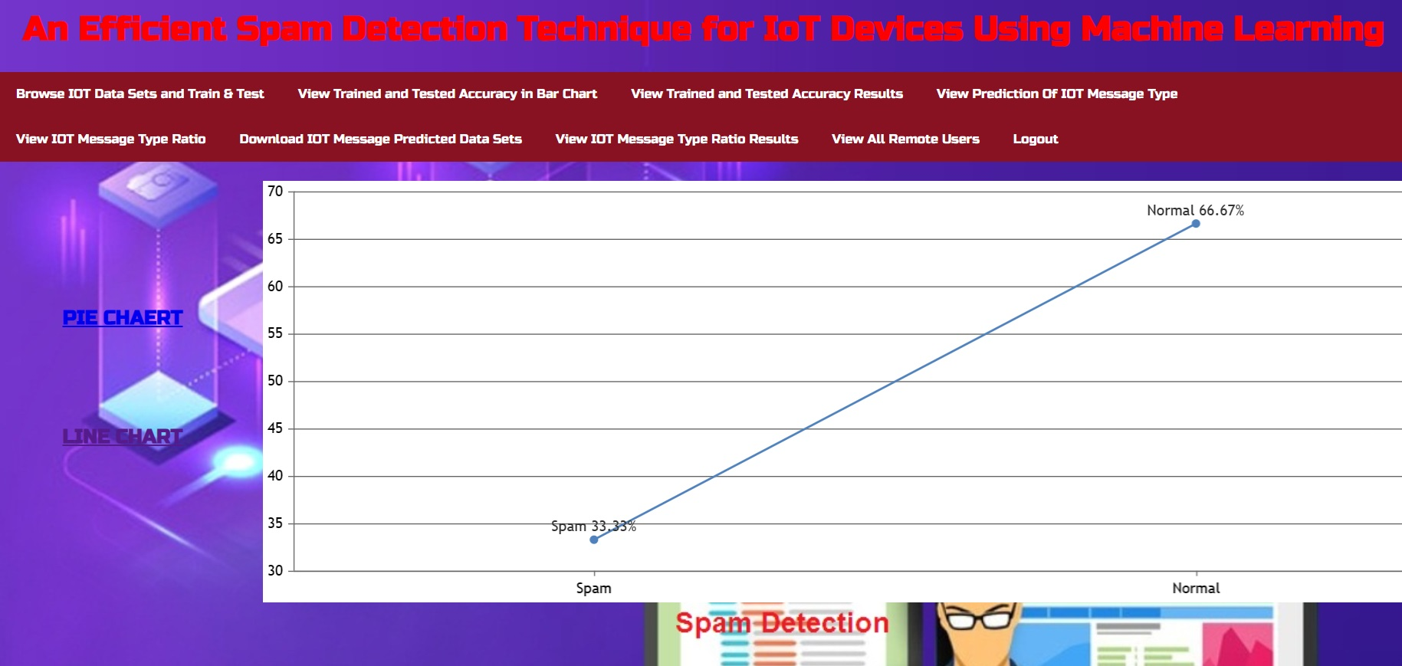
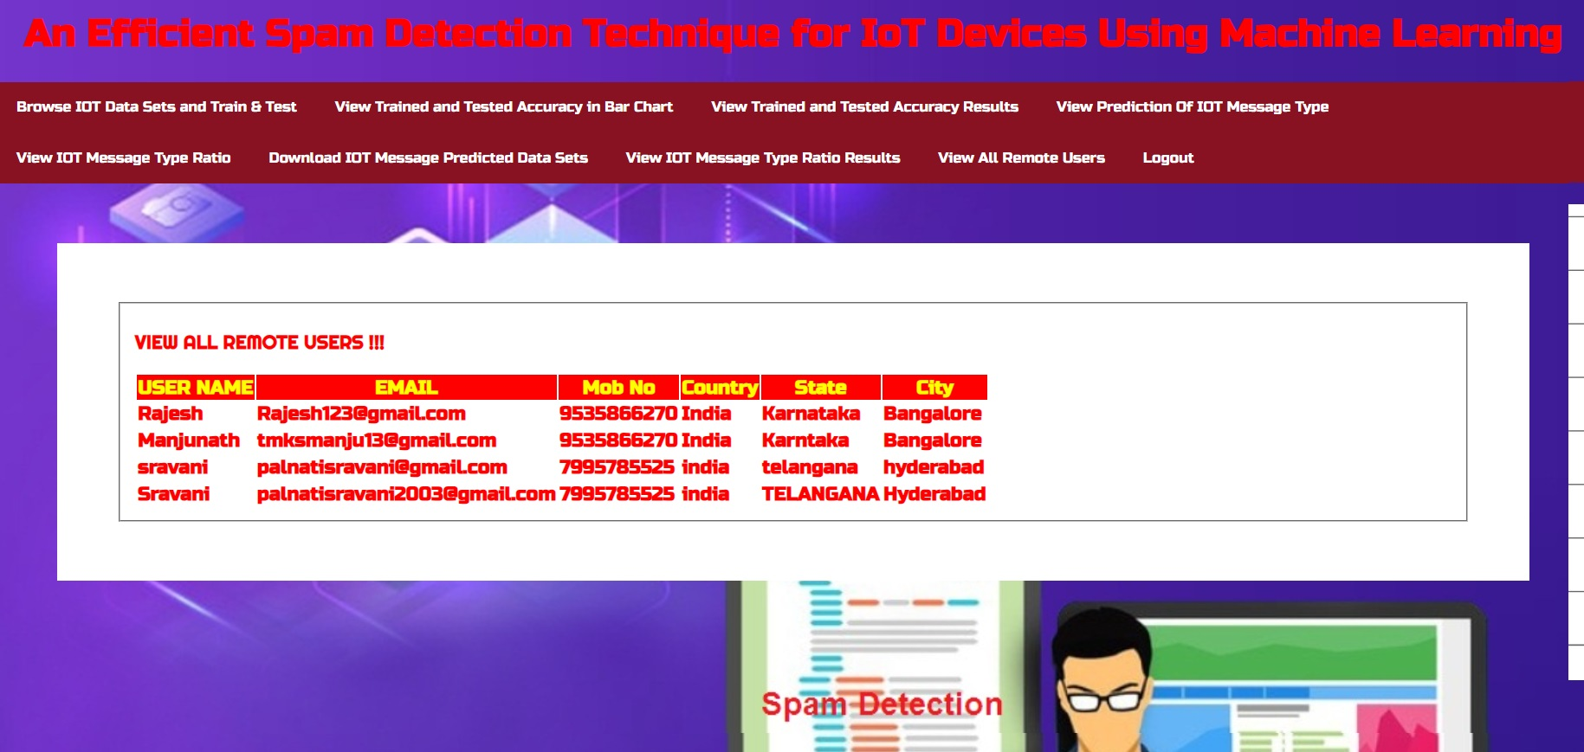
RESULTS
VIEW IOT MESSAGE TYPE RATIO RESULTS
VIEW ALL REMOTE USERS

Slide 25
NOVELTY OF THE PROJECT
The project evaluates spam detection using a diverse set of machine learning models, enhancing the understanding of their efficacy in IoT environments.
Proposing an algorithm to compute the spamicity score of IoT devices based on refined input features provides a quantitative measure of device trustworthiness, a novel approach in spam detection.
Beyond traditional spam detection, the project conducts an analysis of IoT device reliability using various evaluation metrics, offering insights into device performance and security.
Leveraging machine learning enables a scalable framework capable of adapting to the growing volume and complexity of IoT data and devices, ensuring long-term effectiveness.
By employing machine learning, the project enables real-time spam detection, facilitating immediate responses to potential threats and minimizing their impact on IoT systems.
The project's framework allows for customization, enabling the incorporation of different machine learning models and algorithms tailored to specific IoT environments and use cases.
Machine learning-based spam detection techniques are adaptable to new and evolving threats, ensuring continued effectiveness against emerging spam attack techniques in the dynamic IoT landscape.

Slide 26
CONCLUSION
The proposed project offers a robust solution for spam detection in IoT devices using machine learning techniques, addressing the growing security concerns in IoT environments.
By evaluating multiple machine learning models and introducing a novel spamicity score calculation algorithm, the project ensures a comprehensive approach to spam detection, enhancing the reliability and trustworthiness of IoT devices.
The analysis of IoT device reliability and scalability of the proposed framework highlight its adaptability to the evolving landscape of IoT technologies, ensuring long-term effectiveness and sustainability.
Real-time detection capabilities and customization options provide flexibility in addressing diverse spam threats, enabling prompt responses and tailored solutions for different IoT applications.
With the ability to adapt to emerging threats, the proposed project stands as a proactive measure against evolving spam attack techniques, contributing to the overall security and integrity of IoT ecosystems.

Slide 27
FUTURE SCOPE
Integration with Existing Security Solutions:
The project could lead to the integration of machine learning-based Spam mitigation techniques into existing security products and services. This integration can enhance the overall cybersecurity.
Real-time Detection:
Enhance project's ability to detect and respond to Spam attacks in real-time. This can involve optimizing algorithms for implementing streaming data processing, and integrating with network monitoring tools.
Data Augmentation:
Experiment with data augmentation techniques to increase the diversity and size of your training dataset. This can lead to better generalization and robustness of machine learning models.
Large-scale Testing:
Conduct extensive testing of the system in a controlled environment to assess its scalability and performance under heavy Spam attack scenarios.

Slide 28
REFERENCES
[1] Z,-K. Zhang, M. C. Y. Cho, C.-W. Wang, C.-W. Hsu, C.-K. Chen, and S. Shieh, “IoT security: ongoing challenges and research opportunities,” in 2014 IEEE 7th international conference on service-oriented computing and applications. IEEE, 2014, pp. 230–234.
[2] E. Bertino and N. Islam, “Botnets and internet of things security,” Computer, no. 2, pp. 76–79, 2017.
[3] W. Kim, O.-R. Jeong, C. Kim, and J. So, “The dark side of the internet: Attacks, costs and responses,” Information systems, vol. 36, no. 3, pp.675–705, 2011.
[4] M. A. Alsheikh, S. Lin, D. Niyato, and H.-P. Tan, “Machine learning in wireless sensor networks: Algorithms, strategies, and applications,” IEEE Communications Surveys & Tutorials, vol. 16, no. 4, pp. 1996–2018, 2014.
[5] F. A. Narudin, A. Feizollah, N. B. Anuar, and A. Gani, “Evaluation of machine learning classifiers for mobile malware detection,” Soft Computing, vol. 20, no. 1, pp. 343–357, 2016.

Slide 29
GITHUB LINK
GITHUB LINK:
https://github.com/Sravani2510/Spam-Detection-Technique-in-IoT-Devices

Slide 30
THANK YOU!!

